Slide 1


Afsana Rabeya Rukaia
23 December 2024

Slide 2

Outline
Executive Summary
Introduction
Methodology
Results
Conclusion
Appendix

Slide 3
Executive Summary
Data collection, wrangling, and exploratory analysis were conducted using Python and SQL to organize and derive insights. Interactive dashboards (Plotly) and maps (Folium) were utilized for visualization and location analysis. Finally, machine learning models were built to predict future outcomes.

Slide 4
Introduction
To make manned space travel more frequent, it is essential to reduce the associated costs. Achieving this goal requires the recovery of the rocket's first stage, specifically ensuring its successful landing. SpaceX's Falcon 9 exemplifies this innovation, launching like a conventional rocket while also being capable of a safe and efficient landing.
In our project, we aim to develop a machine learning model that not only provides insights into the factors influencing safe landings but also predicts the outcomes of future landings. This approach will contribute to advancing reusable rocket technology, thereby making space exploration more sustainable and cost-effective.

Slide 5

Section 1

Slide 6
Methodology
Executive Summary
Data collection methodology:
Data is collected by using an API and web scraping methods
Perform data wrangling
Perform exploratory data analysis (EDA) using visualization and SQL
Perform interactive visual analytics using Folium and Plotly Dash
Perform predictive analysis using classification models
How to build, tune, evaluate classification models

Slide 7
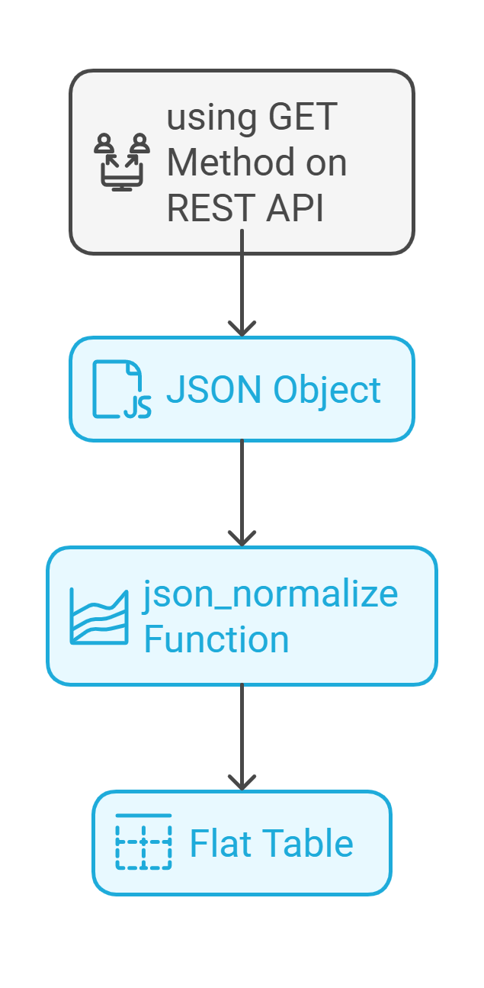
Data Collection – SpaceX API
We collected data using SpaceX REST API. This API will give us data about launches, including information about the rocket used, payload delivered, launch specifications, landing specifications, and landing outcome.
You need to present your data collection process use key phrases and flowcharts
First we used the get method on the rest api and get the data in json object formats. To convert this JSON to a dataframe, we can use the json_normalize function. This function will allow us to “normalize” the structured json data into a flat table.
Github url: https://github.com/RukaiaAfsana/coursera/blob/main/coursera_datascience_capstone/module1/lab1_data_collection_using_REST_API%20.ipynb

Slide 8
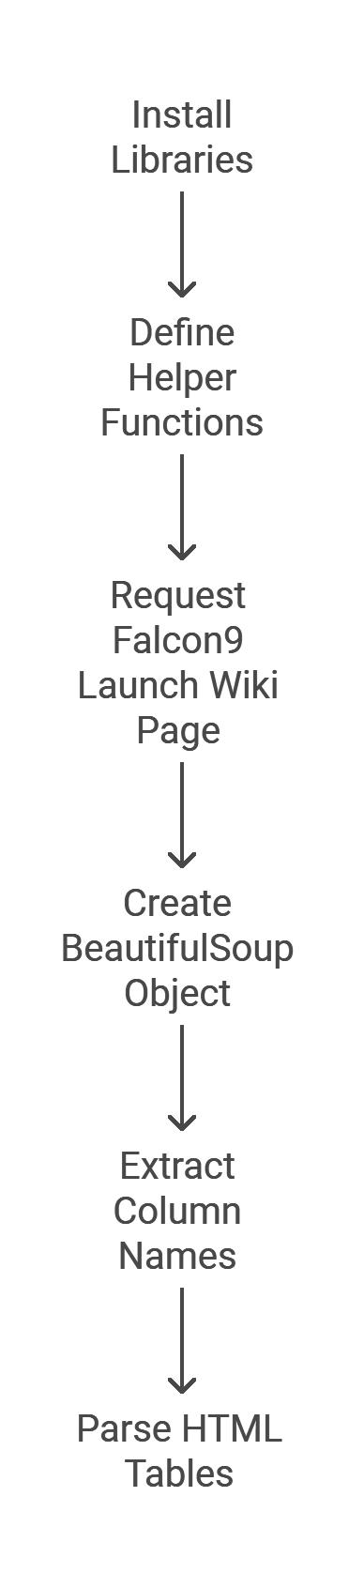
Data Collection - Scraping
The main purpose of this task is to scrape the Falcon 9 Launch Wiki page by sending a request to the URL and parsing the HTML content using BeautifulSoup. It extracts the table header and rows, then converts the data into a pandas DataFrame for easy analysis and manipulation. Some helper functions is introducted for requesting the page, extracting table elements, and creating a DataFrame.
Github https://github.com/RukaiaAfsana/coursera/blob/main/coursera_datascience_capstone/module1/lab2_data_wrangling.ipynb

Slide 9
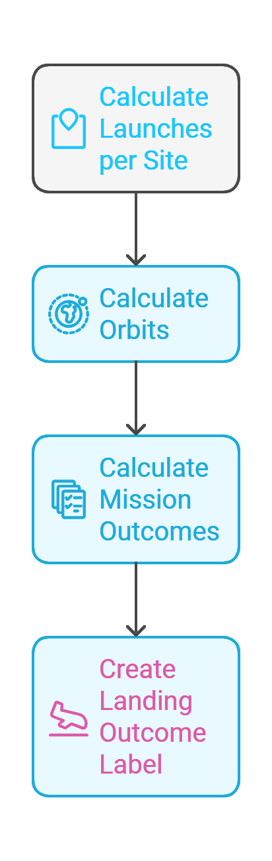
Data Wrangling
The data processing part mainly made the final dataset with outcome column . This task involves analyzing Falcon 9 launch data to calculate the number of launches at each site, the frequency of each orbit, and the mission outcomes for different orbits. Additionally, it includes creating a new Landing_Outcome label derived from the Outcome column to categorize landing results as success or failure. These analyses provide insights into the launch performance and outcomes.
Github url:
https://github.com/RukaiaAfsana/coursera/blob/main/coursera_datascience_capstone/module1/lab3_web_scraping.ipynb

Slide 10
EDA with SQL
SQL aggregate functions :
SUM(): Calculates the total sum of a numeric column.
COUNT(): Counts the number of rows that match a specified criterion.
AVG(): Computes the average value of a numeric column.
MIN(): Finds the minimum value in a column.
MAX(): Finds the maximum value in a column.
Clause:
SELECT: Specifies the columns to be retrieved from a database table.
FROM: Indicates the table from which to retrieve the data.
WHERE: Filters records based on specified conditions.
GROUP BY: Groups rows that have the same values into summary rows, often used with aggregate functions.
ORDER BY: Sorts the result set in either ascending or descending order.
LIMIT: Restricts the number of rows returned by the query.
Github: https://github.com/RukaiaAfsana/coursera/blob/main/coursera_datascience_capstone/module%202/lab1_sql_eda.ipynb

Slide 11
EDA with SQL
SQL quaries:
Retrieve Unique Launch Sites: Identify all distinct launch sites.
SELECT DISTINCT launch_site FROM SPACEXTABLE;
Filter Launch Sites Starting with 'CCA': Find records where the launch site name begins with 'CCA'.
SELECT * FROM SPACEXTABLE WHERE launch_site LIKE 'CCA%' LIMIT 5;
Calculate Total Payload Mass for NASA Missions: Sum the payload mass for missions where the customer is 'NASA (CRS)'.
SELECT SUM(payload_mass_kg) AS total_payload FROM SPACEXTABLE WHERE customer LIKE 'NASA (CRS)';
Compute Average Payload Mass for F9 v1.1 Booster: Find the average payload mass for missions using the 'F9 v1.1' booster version.
SELECT AVG(payload_mass_kg) AS avg_payload FROM SPACEXTABLE WHERE booster_version LIKE 'F9 v1.1';
Identify First Successful Ground Pad Landing Date: Determine the date of the first successful landing on a ground pad.
SELECT MIN(date) AS first_successful_landing FROM SPACEXTABLE WHERE landing_outcome = 'Success (ground pad)';
List Boosters with Specific Landing Outcomes and Payload Mass: Find boosters that successfully landed on a drone ship with a payload mass between 4000 and 6000 kg.
SELECT booster_version FROM SPACEXTABLE WHERE landing_outcome LIKE 'Success (drone ship)' AND payload_mass_kg > 4000 AND payload_mass_kg < 6000;

Slide 12
EDA with SQL
Count Successful and Failed Missions: Count the number of successful and failed missions.
SELECT mission_outcome, COUNT(*) AS total_missions FROM SPACEXTABLE GROUP BY mission_outcome;
Find Booster Versions with Maximum Payload Mass: Identify booster versions that have carried the maximum payload mass.
SELECT booster_version FROM SPACEXTABLE WHERE payload_mass_kg = (SELECT MAX(payload_mass_kg) FROM SPACEXTABLE);
List Records for Specific Landing Outcomes in 2015: Retrieve records for failed drone ship landings in 2015, including month, booster version, and launch site.
SELECT strftime('%m', date) AS month, booster_version, launch_site FROM SPACEXTABLE WHERE landing_outcome LIKE 'Failure (drone ship)' AND strftime('%Y', date) = '2015';
Rank Landing Outcomes Between Specific Dates: Rank the count of landing outcomes between June 4, 2010, and March 20, 2017, in descending order.
SELECT landing_outcome, COUNT(*) AS count FROM SPACEXTABLE WHERE date BETWEEN '2010-

Slide 13
EDA with Data Visualization
Scatter plot
Visualize the relationship between Flight Number and Launch Site, FlightNumber and Orbit type, Payload Mass and Launch Site, Payload Mass and Orbit type
Bar chart
Visualize the relationship between success rate of each orbit type
Lineplot
Visualize the launch success yearly trend
Github:
https://github.com/RukaiaAfsana/coursera/blob/main/coursera_datascience_capstone/module%202/lab2_eda_visualization.ipynb

Slide 14
Build an Interactive Map with Folium
Folium has some objects for mapping and they call map objects:
Markers: These pinpoint specific locations on the map. For instance, adding a marker at a particular latitude and longitude can highlight a point of interest.
Circles and Circle Markers: Circles represent areas with a specific radius in meters, useful for denoting zones like coverage areas. Circle Markers, defined in pixels, are ideal for marking points without scaling with the map's zoom.
Github: https://github.com/RukaiaAfsana/coursera/blob/main/coursera_datascience_capstone/module%203/lab_folium.ipynb

Slide 15
Build a Dashboard with Plotly Dash
1. Dropdown Menu for Launch Site Selection
To allow users to view data specific to a selected launch site or aggregated data for all sites.When a user selects a site from the dropdown, the displayed data in the pie chart and scatter plot updates to reflect the selected site.
2. Pie Chart (Success vs. Failure)
To visualize the proportion of successful and failed launches.For "All Sites," the chart shows the aggregated success vs. failure counts for all launches.For a specific site, the chart displays the success vs. failure counts for that particular site.
3. Payload Range Slider
To allow users to filter the data based on payload mass.Users can adjust the slider to set a minimum and maximum payload range.The scatter plot updates dynamically to display data only for launches within the specified payload range.
4. Scatter Plot (Payload Mass vs. Success)
To analyze the relationship between payload mass and launch success.For "All Sites," the scatter plot displays success/failure data for all sites within the selected payload range.For a specific site, it filters the scatter plot to show data relevant to that site and payload range.Uses color coding (1 as green for success and 0 as red for failure) to make the results intuitive.
Github: https://github.com/RukaiaAfsana/coursera/blob/main/coursera_datascience_capstone/module%203/plotly_Dash.py

Slide 16
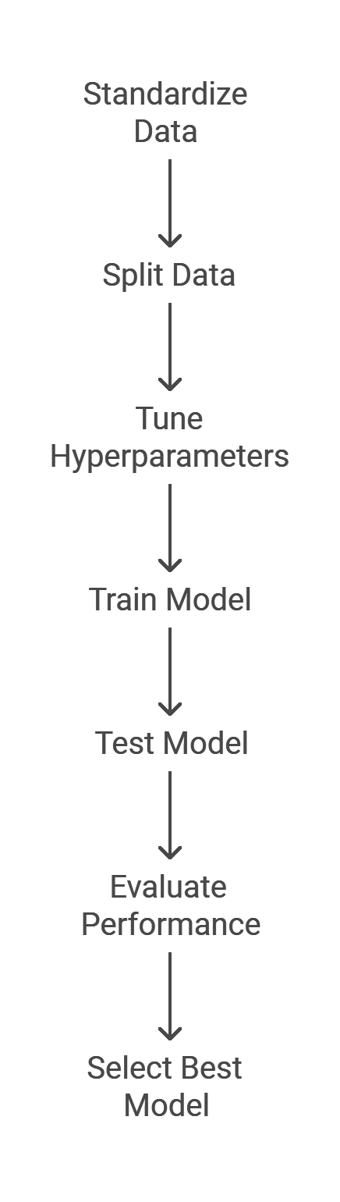
Predictive Analysis (Classification)
The process involves standardizing the data and splitting it into training and testing sets using train_test_split. Hyperparameter tuning is performed with GridSearchCV for multiple models (e.g., Random Forest, SVM, Logistic Regression) to find the best parameters. Each model is trained, evaluated using accuracy scores and confusion matrices, and compared to determine the best-performing model.
https://github.com/RukaiaAfsana/coursera/blob/main/coursera_datascience_capstone/module%204/Grid%20Search%20cv.ipynb

Slide 17
Results
Exploratory data analysis results
Interactive analytics demo in screenshots
Predictive analysis results

Slide 18

Section 2

Slide 19
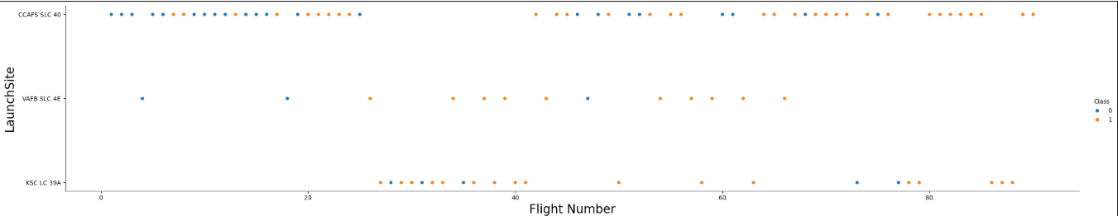
Flight Number vs. Launch Site
The CCAFS SLC-40 Launch Site has the highest number of Flight Number

Slide 20
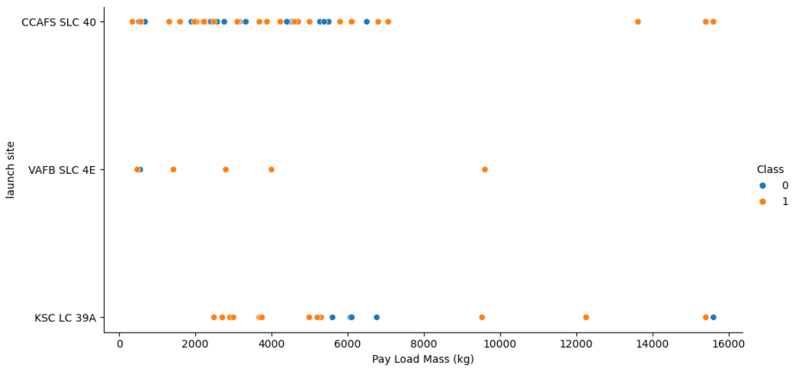
Payload vs. Launch Site
Most of Flights the PayLoad mass are between 8k kgs.

Slide 21
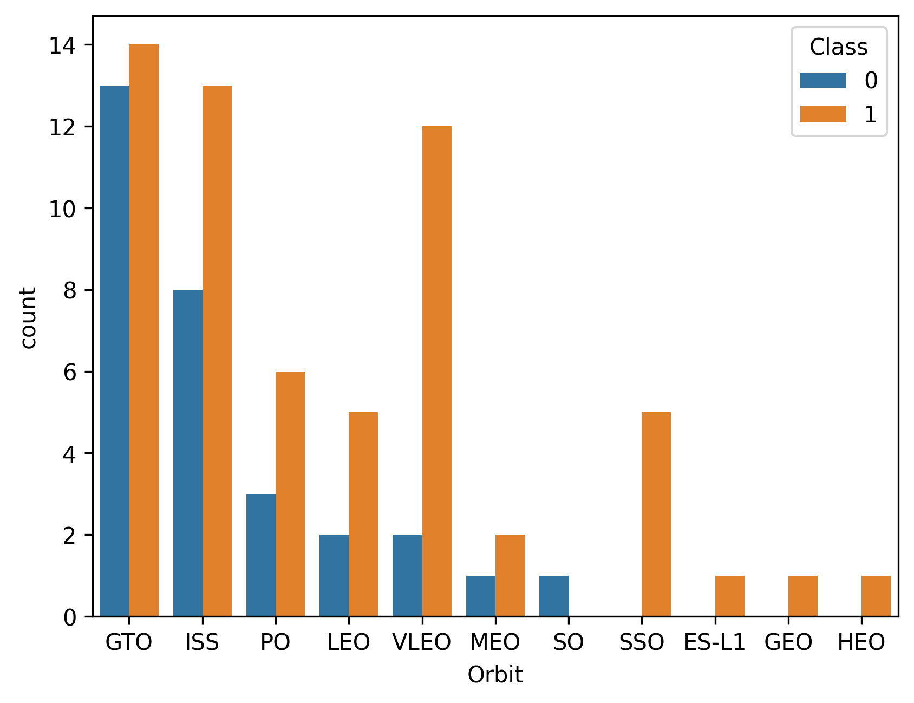
Success Rate vs. Orbit Type
The barchat is showing the GTO orbit has the highest successful landings. But SSO, ES-L1,GEO,HEO these orbit has only successful launches but they also have less amount launches not more than 6.

Slide 22
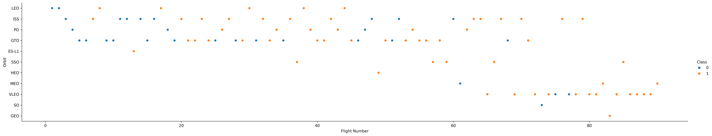
Flight Number vs. Orbit Type
Most of the flights orbit are between GTO,PO, ISS and LEO

Slide 23
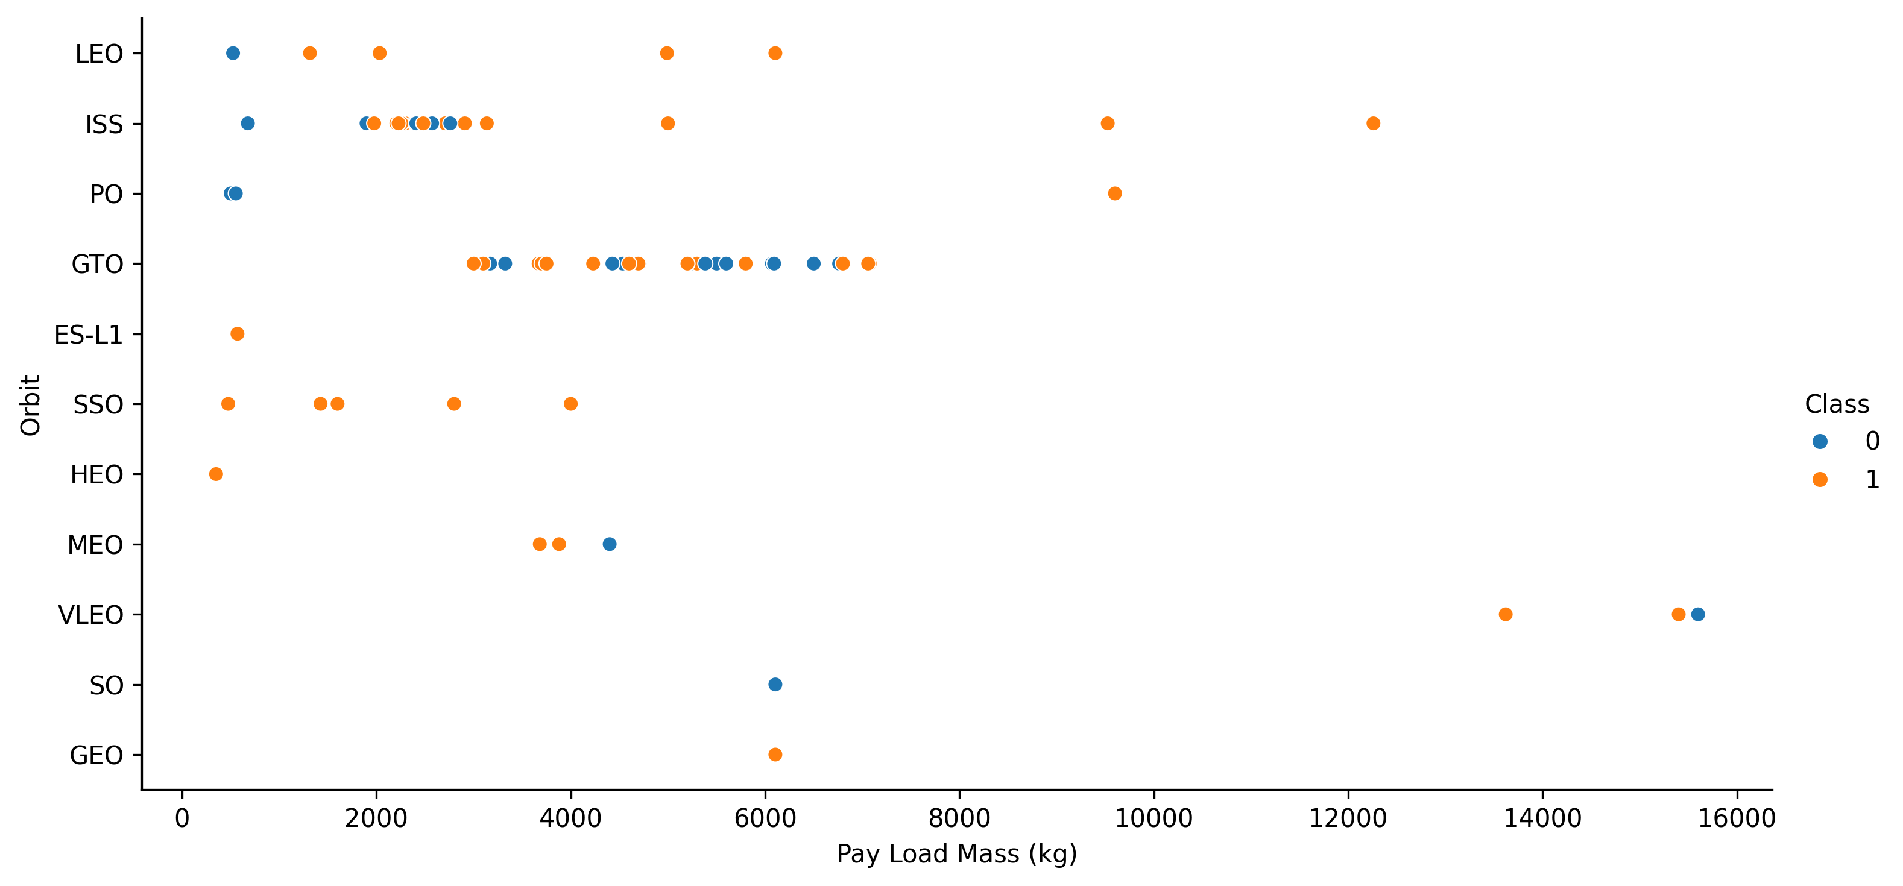
Payload vs. Orbit Type
The mostly used payload mass is in between 6k kgs and the orbits are GTO, ISS, SSO

Slide 24
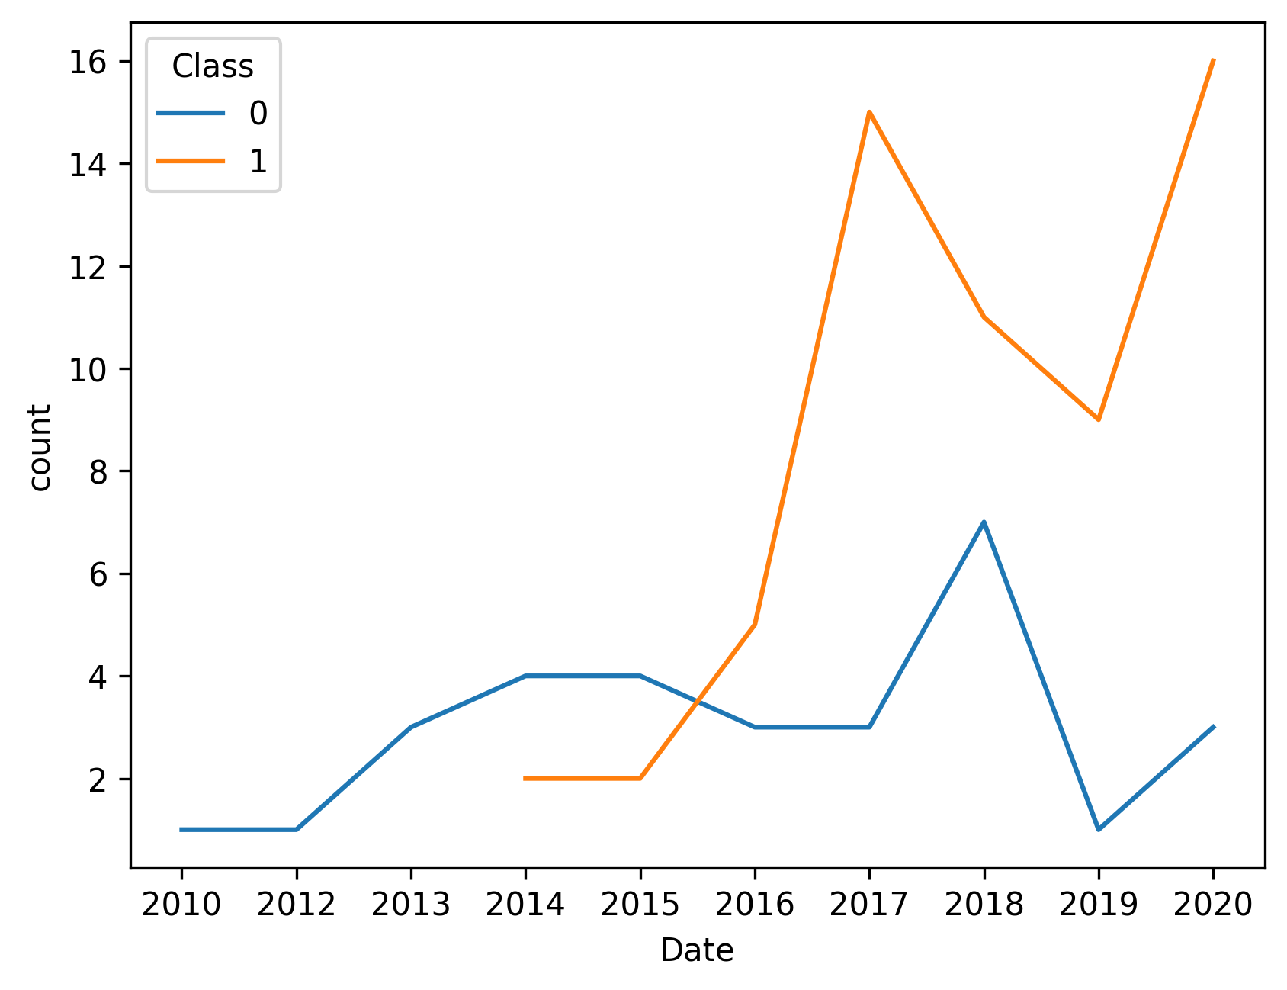
Launch Success Yearly Trend
The Launch success had a raise in the year of 2017 with more than 14 success launches where failure lauches was about 3 that year. The again 2020 had another raise which went to 16 successful launches.

Slide 25
All Launch Site Names
The 4 Launch_Site are :
CCAFS LC-40
VAFB SLC-4E
KSC LC-39A
CCAFS SLC-40

Slide 26
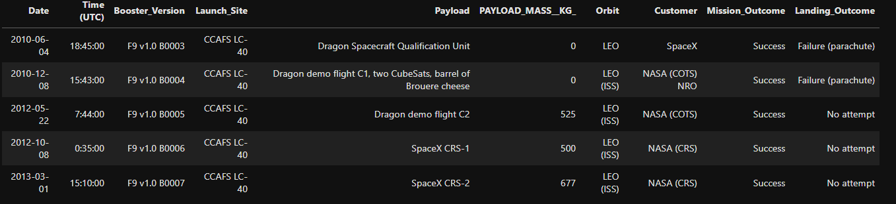
Launch Site Names Begin with 'CCA'
The 5 records where launch sites begin with `CCA`:

Slide 27
Total Payload Mass
The total payload Mass is 45596 for the customer 'NASA (CRS)’.

Slide 28
Average Payload Mass by F9 v1.1
Average Payload Mass by F9 v1.1 2928.4

Slide 29
First Successful Ground Landing Date
First Successful ground landing date is 2015-12-22

Slide 30
Successful Drone Ship Landing with Payload between 4000 and 6000
Booster_Version which successfully landed with Payload between 4000 and 6000
F9 FT B1022
F9 FT B1026
F9 FT B1021.2
F9 FT B1031.2

Slide 31
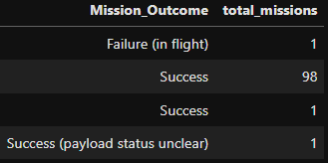
Total Number of Successful and Failure Mission Outcomes
The successful mission outcome is intotal 100 and failure mission outcome is 1

Slide 32
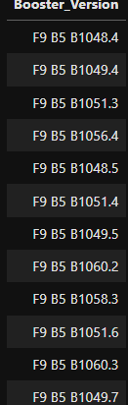
Boosters Carried Maximum Payload
The booster versions carried away the maximum payload mass

Slide 33
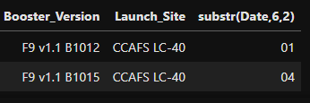
2015 Launch Records
The failed landing_outcomes in drone ship, their booster versions, and launch site names for in year 2015

Slide 34
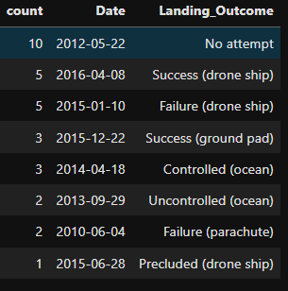
Rank Landing Outcomes Between 2010-06-04 and 2017-03-20
The count of landing outcomes (such as Failure (drone ship) or Success (ground pad)) between the date 2010-06-04 and 2017-03-20, in descending order

Slide 35

Section 3

Slide 36
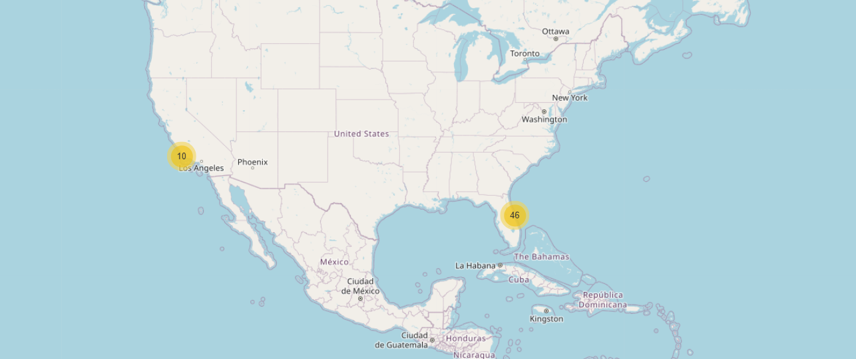
Launch Sites’ Location
All the launch sites are mostly from two port areas of USA. From the right side or Florida, there are 46 total launchs and from Los Angeles there are 10 launchs.

Slide 37
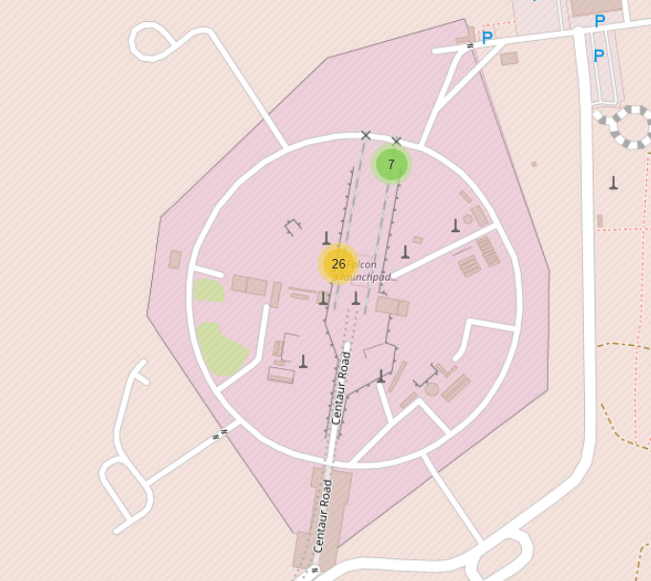
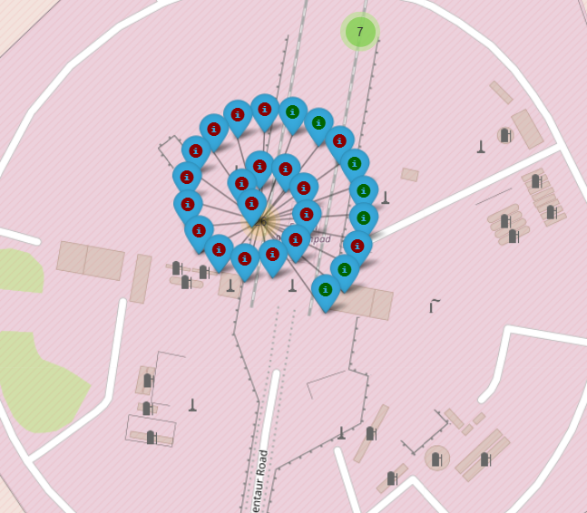
Success Launch on Map
The falcon 9 launch pad’s launch site CCAFSLC-40 has 33 launches but this site also has two separate spots. And on the 26 launches spot, there are 7 successful launches which is shown in green marker

Slide 38

Section 4

Slide 39
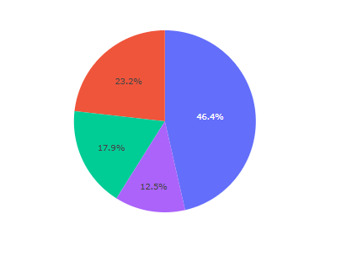
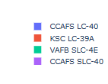
Success and Failure Rate
Red area describes the success and blue is for failure launches. The Pie chart from plotly dash is showing the success rate and the failure rate is almost same for all launches. But success rate is lower than failure .

Slide 40
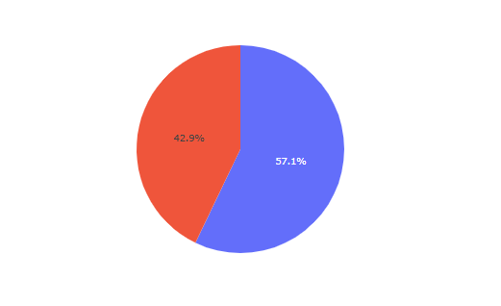
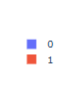
Best Launch site
The highest success rate achieving launch site is CCAFS SLC-40. The total launchs from this site is 7 and 3 got successful.

Slide 41
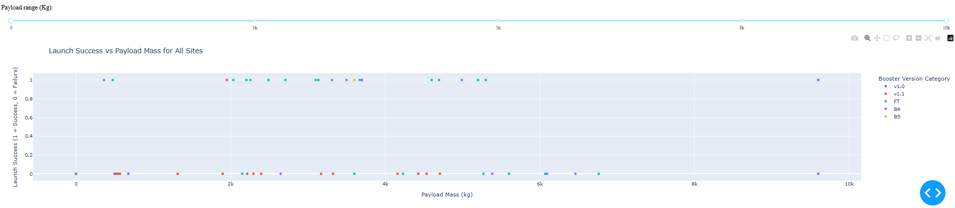
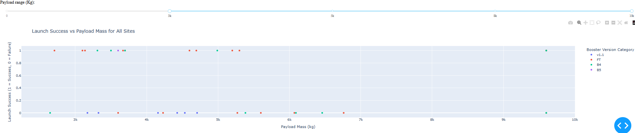
Payload vs. Launch Outcome
Range 0 kgs to3k kgs
Range 3k kgs to 5k kgs

Slide 42
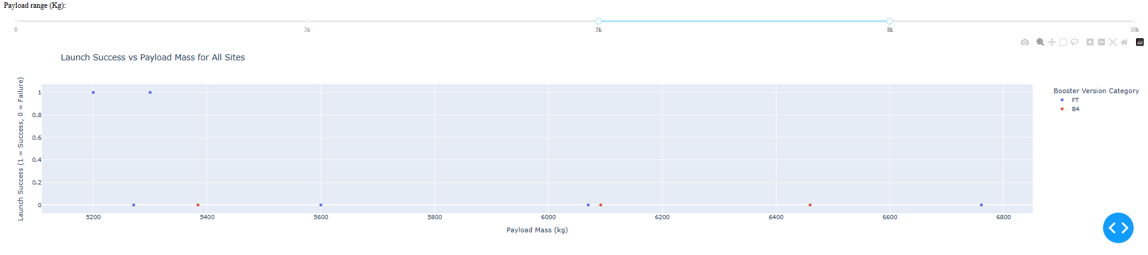
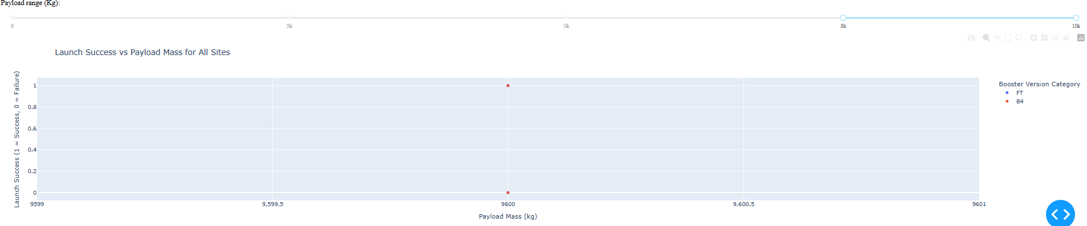
Payload vs. Launch Outcome
Range 5kgs to 8k kgs
Range 8k kgs to 10000kgs

Slide 43
Payload vs. Launch Outcome
The Payload from 3k to 5k have the most number of launches and the highest success launches.
The Booster version FT is successfully launches most of the times. And V1.1 version is the most unsuccessful one.

Slide 44

Section 5

Slide 45
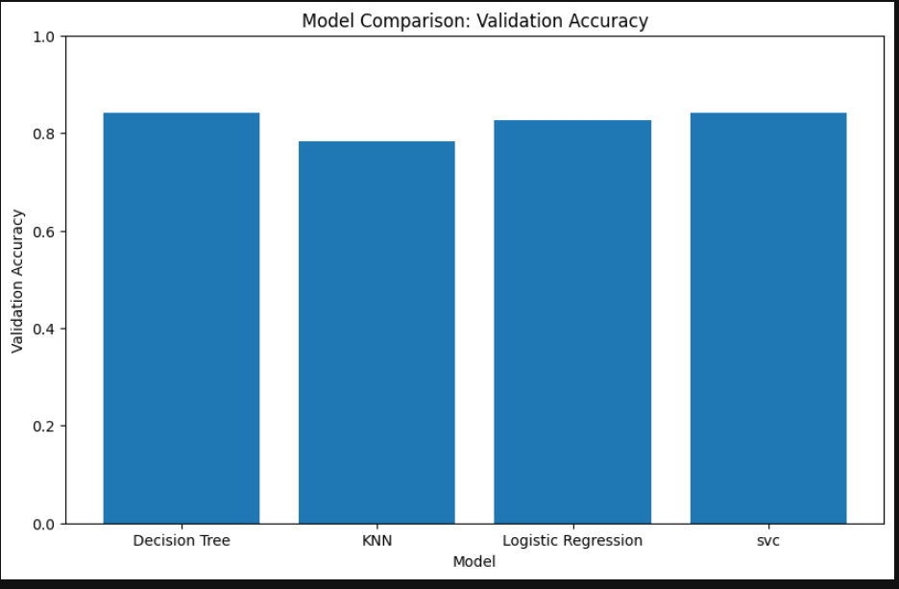
Classification Accuracy
Decision Tree performed the best among all the models with the hyperparameters 'criterion': 'entropy’ and 'max_depth': 30.

Slide 46
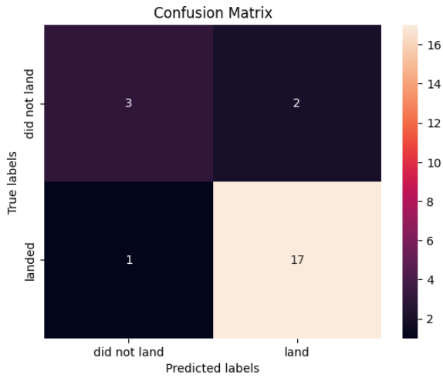
Confusion Matrix
The confusion matrix for the best-performing model(Decision Tree) gives us the insights of the model’s performance. It shows among the 23 total predictions, 20 prediction is correct and 3 prediction is wrong.

Slide 47
Conclusions
Data collection, scraping and data wrangling is done to collect and organize the working dataset
Exploratory Data Analysis is done using python and SQL to analysis the dataset and draw some insights of the dataset.
Plotly dashboard is to interactively analyze the insights
Folium map is for location and map related features
Machine learning models were developed to predict the future outcomes.

Slide 48


